Slide 1


Let’s Learn About Chickens!
An Equal Opportunity, Affirmative Action,
Veteran, Disability Institution

Slide 2
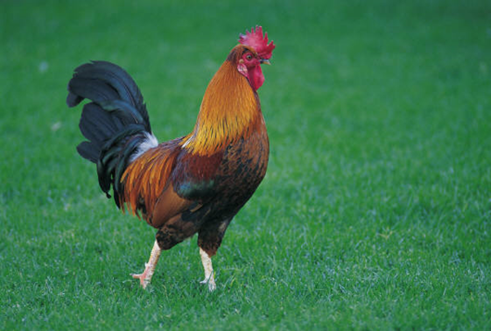
Fun Facts!
Pullet: A young, female chicken
Hen: An adult, female chicken
Rooster: A male chicken
Broiler: Chicken raised for meat
Layer: Chicken raised for eggs
On an average day Georgia produces 26 million pounds of chicken and 9.2 million eggs!
The annual production from an average Georgia poultry farm could feed over 22,000 people per year!

Slide 3
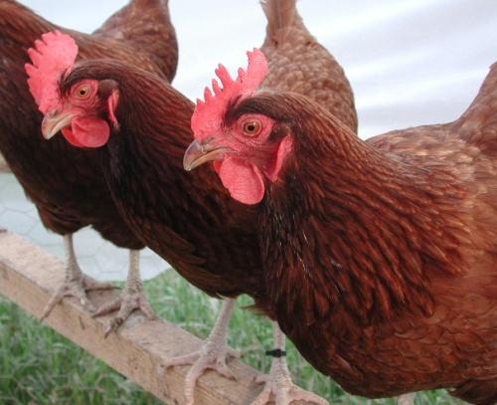
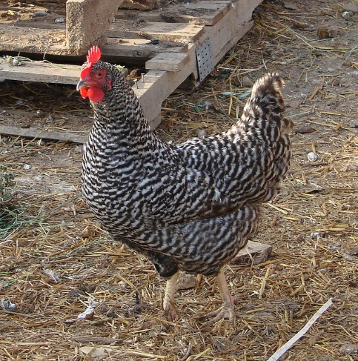
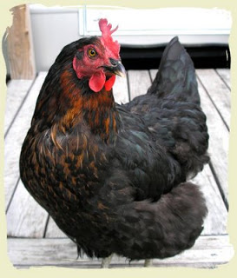
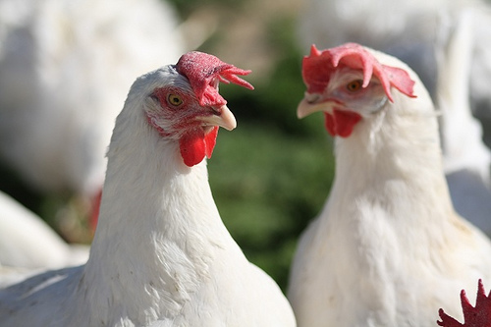
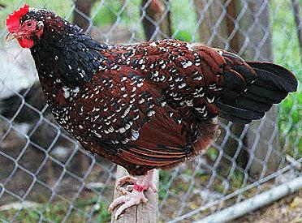
Popular Breeds of Chickens
Black Star
Rhode Island Red
Barred Plymouth Rock
White Leghorn
Speckled Sussex

Slide 4
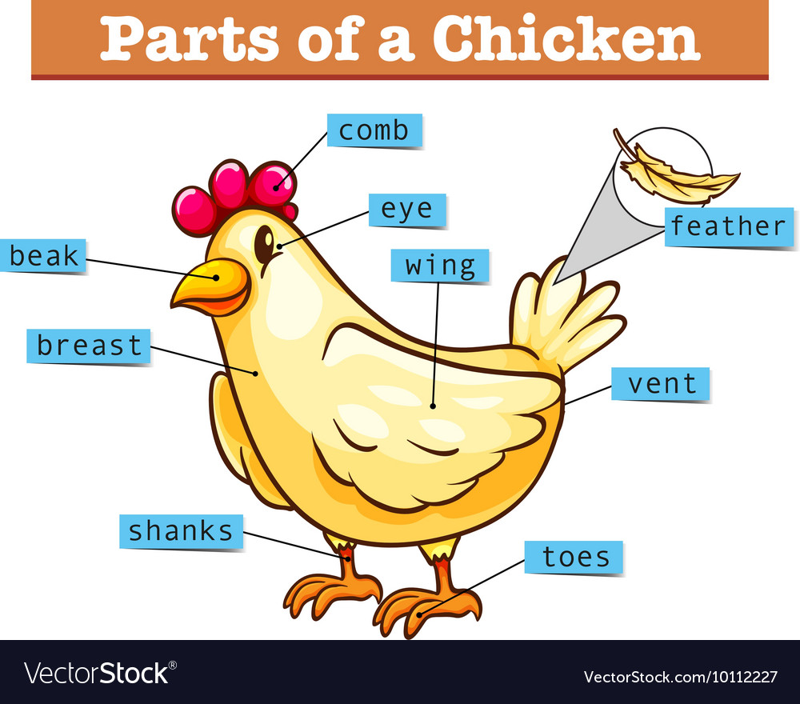

Slide 5


All About Eggs
Eggs are how chickens reproduce.
If there is a rooster present with the hens, most of the eggs will be fertilized. This means a baby chick will form inside.
If a rooster is not present, a hen will still lay eggs. However, they will not be fertilized.
Eggs you buy at the grocery store are not fertilized.

Slide 6
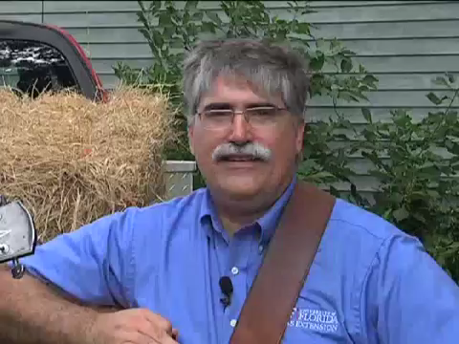

How long to hatch?
21 Days!
http://florida4h.org/embryology/for_kids.shtml

Slide 7
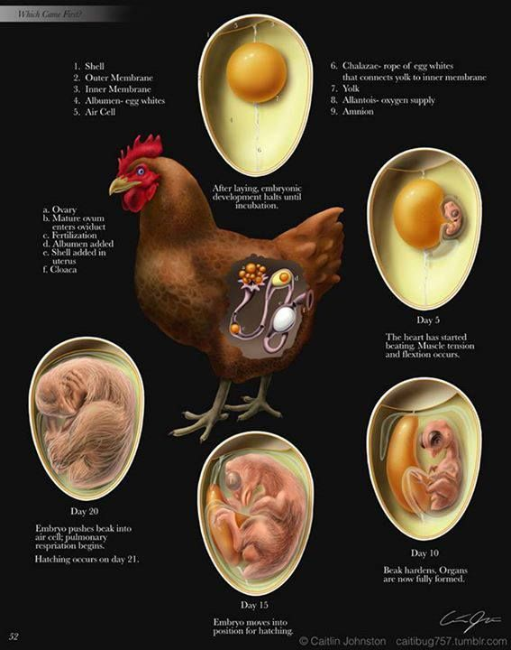
DAY 5
DAY 20
DAY 10
DAY 15

Slide 8

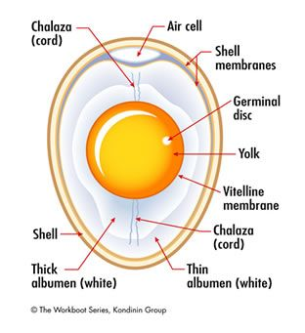
Egg Anatomy!
Shell: Outside protective layer of the egg. Shell color does not effect the nutrition, quality, or flavor of the egg.
Shell Membranes: Inner and Outer membranes help protect the egg.
Air Cell: Found at the large end of the egg. As eggs age, the air cell grows larger.
Albumen: The clear “white” of an egg that is mostly water. It provides food and water for a growing chick.
Chalazae (kuh-lay-zee): Strands that anchor the yolk in the center of the egg.
Yolk: The “yellow” of the egg and makes up 1/3 of the egg’s weight. Can vary in color from light to dark depending on the hen’s diet. Also provides food to the growing chick.
Germ Spot or Disk: White spot on the yolk where the embryo can begin to develop.
https://s-media-cache-ak0.pinimg.com/564x/9c/08/8d/9c088d7de54b24965bd3363d6e5d3426.jpg

Slide 9
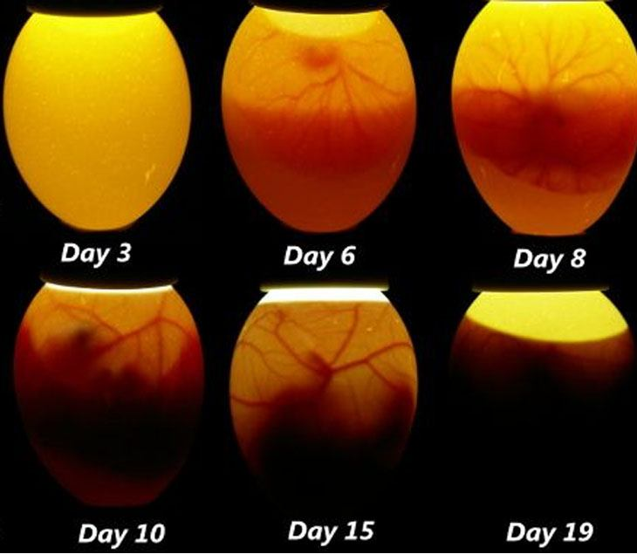
Candling
Using a light to see inside of an egg.
Used to determine the quality and freshness of the egg, or to see if it is fertilized.
What to look for:
  Size of the air cell
  Yolk
  Blood spots or defects
This Photo by Unknown Author is licensed under CC BY-SA

Slide 10
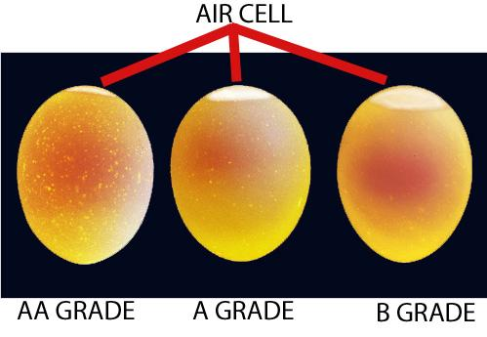
Egg Quality
https://www.colorado.gov/pacific/sites/default/files/u/6556/Egg-Grading.JPG

Slide 11

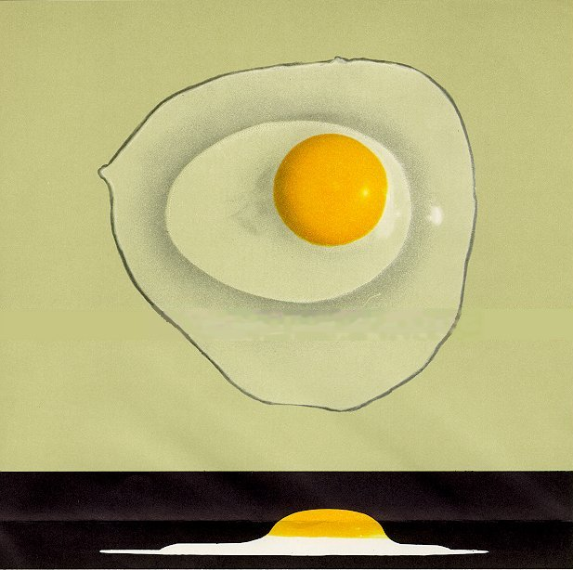
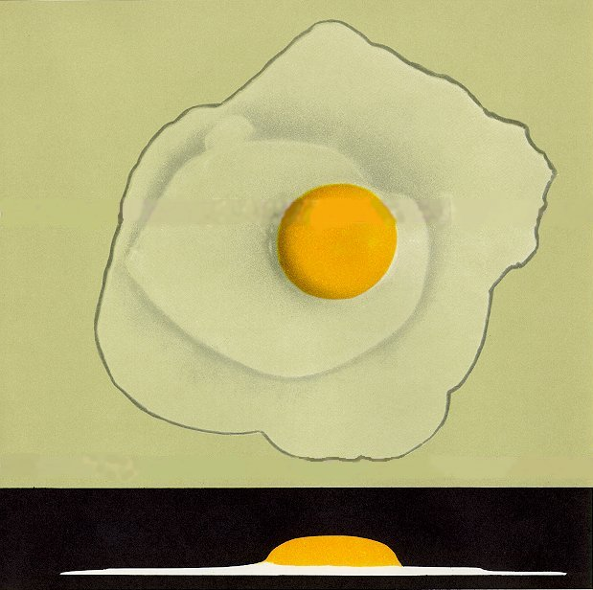
Broken-out Quality
AA
A
B
4h.missouri.edu

Slide 12
References
Tennessee Department of Agriculture
www.tn.gov/agriculture
Tennessee Poultry Association
www.tnpoultry.org
Food and Agriculture Organization of the United Nations
http://www.fao.org/ag/againfo/themes/en/meat/backgr_sources.html

