Slide 1
COMMON GARDEN WEEDS

Slide 2
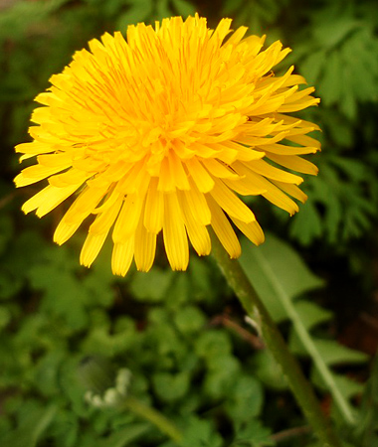
DANDELION

Slide 3
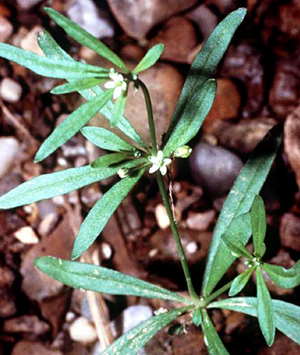
CARPETWEED

Slide 4
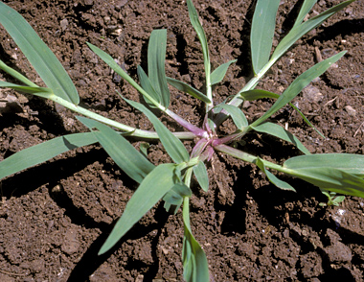
CRABGRASS

Slide 5
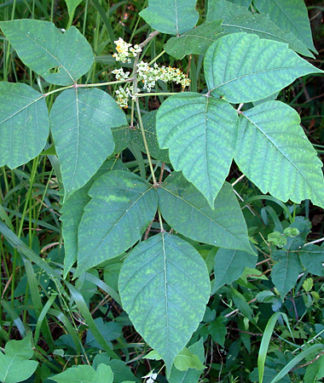
POISON IVY

Slide 6
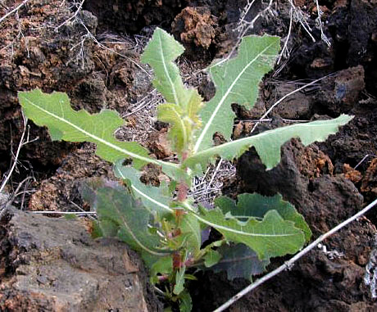
PRICKLY LETTUCE

Slide 7
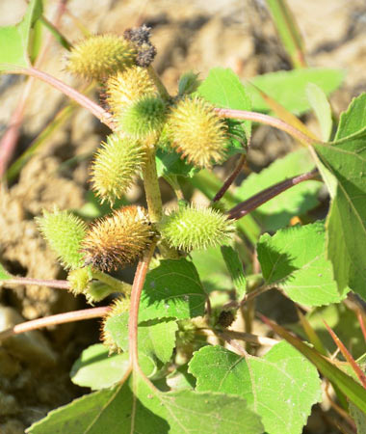
COCKLEBUR

Slide 8
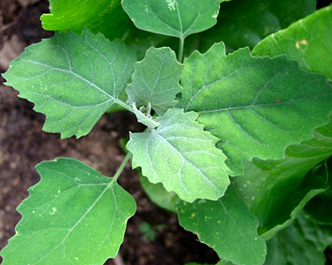
LAMBSQUARTERS

Slide 9
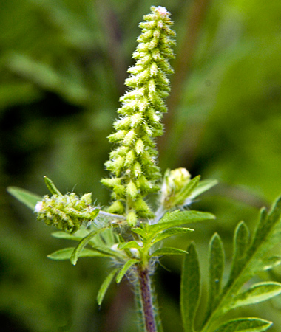
RAGWEED

Slide 10
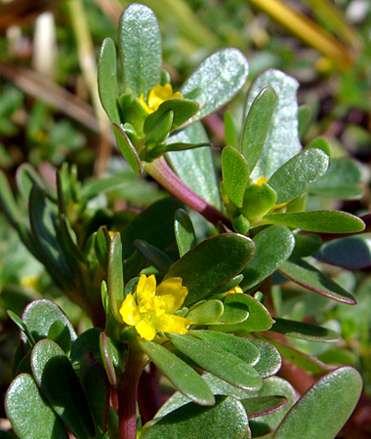
PURSLANE

Slide 11
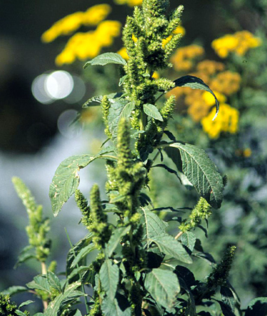
PIGWEED

